Slide 1
Operating Systems Spring 2023
National University of Computer and Emerging Sciences
0-Preliminaries
1

Slide 2
About Me
Khwaja Bilal Hassan
BSCS From UET Peshawar 2016, (Gold Medal)
Mphil CS From Quaid-i-Azam University 2019
Teaching Experience:
BIIT
Air University
SZABIST Islamabad

Slide 3
Outline
Basic Information
Motivation
Brief history of operating systems
Course overview
Course information
3

Slide 4
Acknowledgment
Acknowledgements to
Marina Papatriantafilou (Chalmers)
Maarten van Steen (Vrije Amsterdam)
Boris Koldehofe (TU Darmstadt)
A lot of the course material is based on their lecture notes
Many Slides and Figures are also based on instructor material of various books
William Stallings (Operating systems)
Abraham Silberschatz (Operating System Concepts)
Andrew Tanenbaum (Modern Operating System Concepts)
4

Slide 5
What to Learn in This Course?
Understand concepts of modern operating systems
Design principles
Data structures, kernel organization, ...
Fundamental concepts
Processes, Threads, Virtual Memory, File and I/O, ...
Basic algorithms
Scheduling, Paging, Resource Allocation, ...
Characteristics/performance of a system
Thrashing, Throughput, Real-time, ...
Concurrent programming concepts
Synchronization, Mutual exclusion, Deadlock avoidance, ...
BUT: No focus on a specific operating system
19

Slide 6
Course Outline
Introduction
Processes management
Multithreaded programming
Process scheduling
Process Coordination
Synchronization
Deadlock
Memory Management
Virtual memory
Storage Management
File system
I/O system
20

Slide 7
Pre-Requisites
Must have passed data structures (CS-201)
Familiar with programming C/C++

Slide 8
Tentative Evaluation Breakdown
Evaluation Name | Weightage
Assignment* | 15
Quiz | 10
Project | 10
Sessional I & II | 25
Final | 40
The evaluation breakdown and course outline for all sections will be same
Grading will be combined so don’t rely on your class position look for the batch position
Absolute grading will be used.

Slide 9
Some Rules
Class participation is important and encouraged
Wait for others to complete
Never ever miss a class
You might miss quiz
Never use mobile phone in the class
Above all, whatever you do, please do not disturb others

Slide 10
Retake Policy
No retake for assignments and quizzes
No retake of mid term exam
– Marks will be awarded based on the performance in the final exam
Retake of project demos will be evaluated on individual basis
Retake of final exam will be decided by the university policy

Slide 11
Dishonesty and Plagiarism
Any kind of cheating will be considered serious offense
All parties involve in cheating will get zero marks
– Quizzes, assignments and project
Habitual cases will be referred to DC

Slide 12
Attendance Policy
A student is either “present” or “absent”
Late arrivals will be treated as absent
Student arriving 10 minutes late will be marked absent
Students are not allowed to switch sections for any reason

Slide 13
Course Material (1)
Course book
Avi Silberschatz, Peter Baer, and Galvin Greg Gagne: Operating System Concepts, 8/E, John Wiley & Sons.
Research books
William Stallings: Operating Systems: Internals & Design Principles, 6/E, Prentice Hall.
Andrew S. Tanenbaum: Modern Operating Systems, 3/E, Prentice Hall.
Andrew S Tanenbaum and Albert S Woodhull: OS Design and Implementation, 3/E, Prentice Hall.

Slide 14
Course Material (2)
Lecture slides and announcements for all sections
Google Classroom: Operating Systems Spring 2023
Class Code: ojktc3u

Slide 15
Basic Elements
Processor
Main Memory
I/O Modules
System Bus
Notes:
At a top level, a computer consists of processor, memory, and I/O components, with one or more modules of each type. These components are interconnected in some
fashion to achieve the main function of the computer, which is to execute programs. Thus, there are four main structural elements:
Processor
I/O Modules
Main Memory
System Bus

Slide 16
Processor
Controls the operation of the computer
Performs the data processing functions
Referred to as the Central Processing Unit (CPU)
Notes:
Processor : Controls the operation of the computer and performs its data processing functions. When there is only one processor, it is often referred to as the central processing unit (CPU).

Slide 17
Main Memory
Volatile
Contents of the memory is lost when the computer is shut down
Referred to as real memory or primary memory
Notes:
Main memory : Stores data and programs. This memory is typically volatile; that is, when the computer is shut down, the contents of the memory are lost. In contrast, the contents of disk memory are retained even when the computer system is shut down. Main memory is also referred to as real memory or primary memory.

Slide 18
I/O Modules
Moves data between the computer and external environments such as:
storage (e.g. hard drive)
communications equipment
terminals
Notes:
I/O modules : Move data between the computer and its external environment. The external environment consists of a variety of devices, including secondary
memory devices (e.g., disks), communications equipment, and terminals.

Slide 19
System Bus
Provides for communication among processors, main memory, and I/O modules
Notes:
System bus : Provides for communication among processors, main memory, and I/O modules.

Slide 20
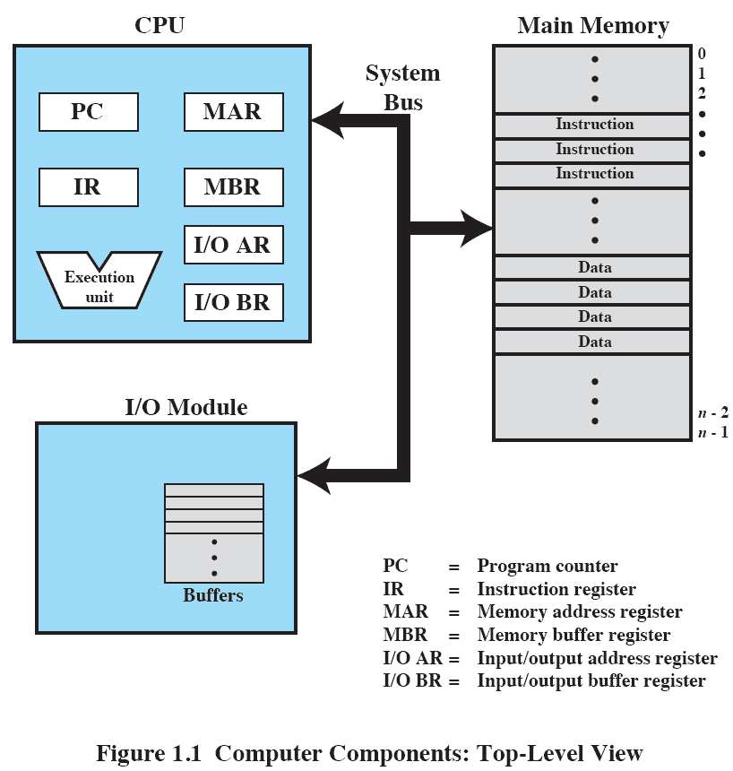
Top-Level View
Notes:
Figure 1.1 depicts these top-level components. One of the processor’s functions is to exchange data with memory. For this purpose, it typically makes use of two internal (to the processor) registers: a memory address register (MAR), which specifies the address in memory for the next read or write; and a memory buffer register (MBR), which contains the data to be written into memory or which receives the data read from memory. Similarly, an I/O address register (I/OAR) specifies a particular I/O device. An I/O buffer register (I/OBR) is used for the exchange of data between an I/O module and the processor.
A memory module consists of a set of locations, defined by sequentially numbered addresses. Each location contains a bit pattern that can be interpreted as either an instruction or data. An I/O module transfers data from external devices to processor and memory, and vice versa. It contains internal buffers for temporarily holding data until they can be sent on.

Slide 21
How CPU works?
http://www.youtube.com/watch?v=cNN_tTXABUA
http://www.youtube.com/watch?v=g_IaVepNDT4
http://www.youtube.com/watch?v=c06WxAvD4Nk

Slide 22
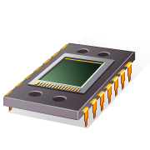
Microprocessor
Invention that brought about desktop and handheld computing
Processor on a single chip
Fastest general purpose processor
Multiprocessors
Each chip (socket) contains multiple processors (cores)
Notes:
The hardware revolution that brought about desktop and handheld computing was the invention of the microprocessor, which contained a processor on a single chip. Though originally much slower than multichip processors, microprocessors have continually evolved to the point that they are now much faster for most computations due to the physics involved in moving information around in sub-nanosecond timeframes.
Not only have microprocessors become the fastest general purpose processors available, they are now multiprocessors; each chip (called a socket) contains multiple processors (called cores), each with multiple levels of large memory caches, and multiple logical processors sharing the execution units of each core. As of 2010, it is not unusual for even a laptop to have 2 or 4 cores, each with 2 hardware threads, for a total of 4 or 8 logical processors.

Slide 23
Graphical Processing Units (GPU’s)
Provide efficient computation on arrays of data using Single-Instruction Multiple Data (SIMD) techniques
Used for general numerical processing
Physics simulations for games
Computations on large spreadsheets
G
P
U
Notes:
Although processors provide very good performance for most forms of computing, there is increasing demand for numerical computation. Graphical Processing Units (GPUs) provide efficient computation on arrays of data using Single-Instruction Multiple Data (SIMD) techniques pioneered in supercomputers. GPUs are no longer used just for rendering advanced graphics, but they are also used for general numerical processing, such as physics simulations for games or computations on large spreadsheets. Simultaneously, the CPUs themselves are gaining the capability of operating on arrays of data—with increasingly powerful vector units integrated into the processor architecture of the x86 and AMD64 families. Processors and GPUs are not the end of the computational story for the modern PC.

Slide 24
Digital Signal Processors (DSPs)
Deal with streaming signals such as audio or video
Used to be embedded in devices like modems
Encoding/decoding speech and video (codecs)
Support for encryption and security
D
S
P
Notes:
Digital Signal Processors (DSPs) are also present, for dealing with streaming signals—such as audio or video. DSPs used to be embedded in I/O devices, like modems, but they are now becoming first-class computational devices, especially in handhelds. Other specialized computational devices (fixed function units) co-exist with the CPU to support other standard computations, such as encoding/decoding speech and video (codecs), or providing support for encryption and security.

Slide 25

System on a Chip (SoC)
To satisfy the requirements of handheld devices, the microprocessor is giving way to the SoC
Components such as DSPs, GPUs, codecs and main memory, in addition to the CPUs and caches, are on the same chip
Notes:
To satisfy the requirements of handheld devices, the classic microprocessor is giving way to the System on a Chip (SoC), where not just the CPUs and caches are on the same chip, but also many of the other components of the system, such as DSPs, GPUs, I/O devices (such as radios and codecs), and main memory.

Slide 26
Instruction Execution
A program consists of a set of instructions stored in memory
Two steps:
processor reads (fetches) instructions from memory
processor executes each instruction
Notes:
A program to be executed by a processor consists of a set of instructions stored in memory. In its simplest form, instruction processing consists of two steps: The processor reads ( fetches ) instructions from memory one at a time and executes each instruction. Program execution consists of repeating the process of instruction fetch and instruction execution. Instruction execution may involve several operations and depends on the nature of the instruction.

Slide 27
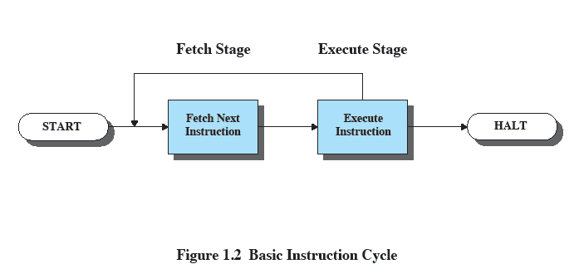
Basic Instruction Cycle
Notes:
The processing required for a single instruction is called an instruction cycle. Using a simplified two-step description, the instruction cycle is depicted in Figure 1.2 . The two steps are referred to as the fetch stage and the execute stage. Program execution halts only if the processor is turned off, some sort of unrecoverable error occurs, or a program instruction that halts the processor is encountered.

Slide 28
Instruction Fetch and Execute
The processor fetches the instruction from memory
Program counter (PC) holds address of the instruction to be fetched next
PC is incremented after each fetch
Notes:
At the beginning of each instruction cycle, the processor fetches an instruction from memory. Typically, the program counter (PC) holds the address of the next instruction to be fetched. Unless instructed otherwise, the processor always increments the PC after each instruction fetch so that it will fetch the next instruction in sequence (i.e., the instruction located at the next higher memory address).

Slide 29


Instruction Register (IR)
Fetched instruction is loaded into Instruction Register (IR)
Processor interprets the instruction and performs required action:
Processor-memory
Processor-I/O
Data processing
Control
Notes:
The fetched instruction is loaded into the instruction register (IR). The instruction contains bits that specify the action the processor is to take. The processor interprets the instruction and performs the required action. In general, these actions fall into four categories:
• Processor-memory: Data may be transferred from processor to memory or from memory to processor.
• Processor-I/O: Data may be transferred to or from a peripheral device by transferring between the processor and an I/O module.
• Data processing: The processor may perform some arithmetic or logic operation on data.
• Control: An instruction may specify that the sequence of execution be altered.
An instruction’s execution may involve a combination of these actions.

Slide 30
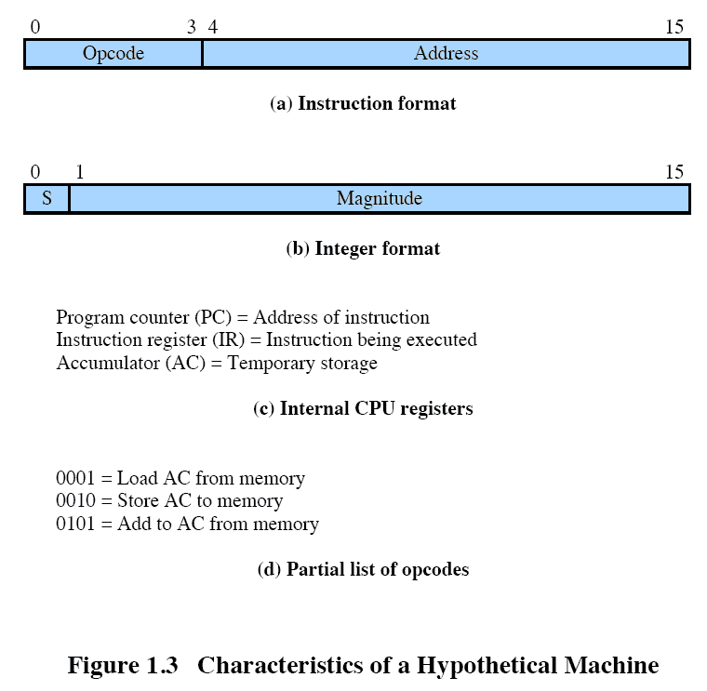
Characteristics of a Hypothetical Machine
Notes:
Consider a simple example using a hypothetical processor that includes the characteristics listed in Figure 1.3 . The processor contains a single data register, called the accumulator (AC). Both instructions and data are 16 bits long, and memory is organized as a sequence of 16-bit words. The instruction format provides 4 bits for the opcode, allowing as many as 24 16 different opcodes (represented by a single hexadecimal 1 digit). The opcode defines the operation the processor is to perform. With the remaining 12 bits of the instruction format, up to
212 4,096 (4K) words of memory (denoted by three hexadecimal digits) can be directly addressed.

Slide 31
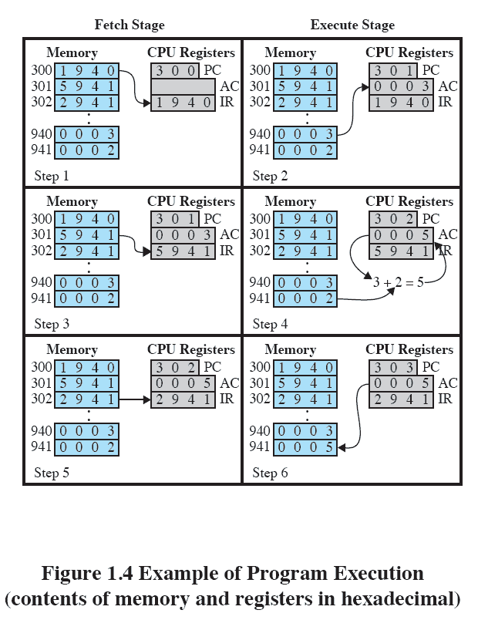
Example of Program Execution
Notes:
Figure 1.4 illustrates a partial program execution, showing the relevant portions of memory and processor registers. The program fragment shown adds the contents of the memory word at address 940 to the contents of the memory word at address 941 and stores the result in the latter location. Three instructions, which can be described as three fetch and three execute stages, are required:
The PC contains 300, the address of the first instruction. This instruction (the value 1940 in hexadecimal) is loaded into the IR and the PC is incremented. Note that this process involves the use of a memory address register (MAR) and a memory buffer register (MBR). For simplicity, these intermediate registers are not shown.
2. The first 4 bits (first hexadecimal digit) in the IR indicate that the AC is to be loaded from memory. The remaining 12 bits (three hexadecimal digits) specify the address, which is 940.
3. The next instruction (5941) is fetched from location 301 and the PC is incremented.
4. The old contents of the AC and the contents of location 941 are added and the result is stored in the AC.
5. The next instruction (2941) is fetched from location 302 and the PC is incremented.
6. The contents of the AC are stored in location 941.
In this example, three instruction cycles, each consisting of a fetch stage and
an execute stage, are needed to add the contents of location 940 to the contents
of 941. With a more complex set of instructions, fewer instruction cycles would be
needed. Most modern processors include instructions that contain more than one
address. Thus the execution stage for a particular instruction may involve more than
one reference to memory. Also, instead of memory references, an instruction may
specify an I/O operation.

Slide 32
Interrupts
Interrupt the normal sequencing of the processor
Provided to improve processor utilization
most I/O devices are slower than the processor
processor must pause to wait for device
wasteful use of the processor
Notes:
Virtually all computers provide a mechanism by which other modules (I/O, memory) may interrupt the normal sequencing of the processor.
Interrupts are provided primarily as a way to improve processor utilization. For example, most I/O devices are much slower than the processor. Suppose that the processor is transferring data to a printer using the instruction cycle scheme of Figure 1.2 . After each write operation, the processor must pause and remain idle until the printer catches up. The length of this pause may be on the order of many thousands or even millions of instruction cycles. Clearly, this is a very wasteful use of the processor.

Slide 33
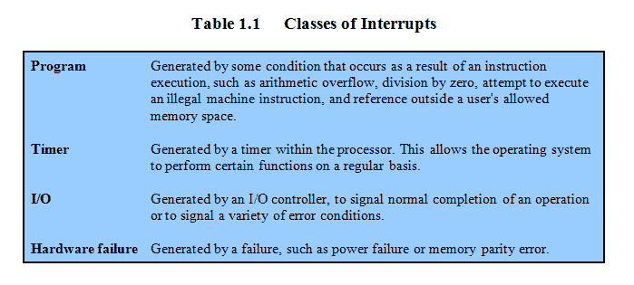
Common Classes of Interrupts
Notes:
Table 1.1 lists the most common classes of interrupts.

Slide 34
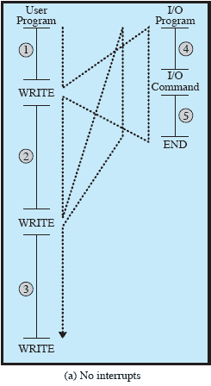
Flow of Control Without Interrupts
Notes:
To give a specific example, consider a PC that operates at 1 GHz, which would allow roughly 10 9 instructions per second. 2 A typical hard disk has a rotational speed of 7200 revolutions per minute for a half-track rotation time of 4 ms, which is 4 million times slower than the processor.
Figure 1.5a illustrates this state of affairs. The user program performs a series of WRITE calls interleaved with processing. The solid vertical lines represent segments of code in a program. Code segments 1, 2, and 3 refer to sequences of instructions that do not involve I/O. The WRITE calls are to an I/O routine that is a system utility and that will perform the actual I/O operation. The I/O program consists of three sections:
• A sequence of instructions, labeled 4 in the figure, to prepare for the actual I/O operation. This may include copying the data to be output into a special buffer and preparing the parameters for a device command.
• The actual I/O command. Without the use of interrupts, once this command is issued, the program must wait for the I/O device to perform the requested function (or periodically check the status, or poll, the I/O device). The program might wait by simply repeatedly performing a test operation to determine if the I/O operation is done.
• A sequence of instructions, labeled 5 in the figure, to complete the operation. This may include setting a flag indicating the success or failure of the operation. The dashed line represents the path of execution followed by the processor; that is, this line shows the sequence in which instructions are executed. Thus, after the first WRITE instruction is encountered, the user program is interrupted and execution continues with the I/O program. After the I/O program execution is complete, execution resumes in the user program immediately following the WRITE
Instruction. Because the I/O operation may take a relatively long time to complete, the I/O program is hung up waiting for the operation to complete; hence, the user program is stopped at the point of the WRITE call for some considerable period of time.

Slide 35
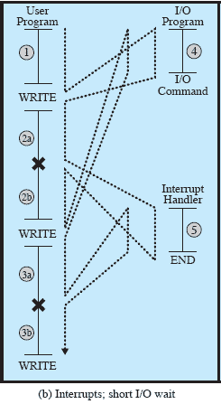
Interrupts: Short I/O Wait
Notes:
With interrupts, the processor can be engaged in executing other instructions while an I/O operation is in progress. Consider the flow of control in Figure 1.5b . As before, the user program reaches a point at which it makes a system call in the form of a WRITE call. The I/O program that is invoked in this case consists only of the preparation code and the actual I/O command. After these few instructions have been executed, control returns to the user program. Meanwhile, the external device is busy accepting data from computer memory and printing it. This I/O operation is conducted concurrently with the execution of instructions in the user program.
When the external device becomes ready to be serviced, that is, when it is ready to accept more data from the processor, the I/O module for that external device sends an interrupt request signal to the processor. The processor responds by suspending operation of the current program; branching off to a routine to service that particular I/O device, known as an interrupt handler; and resuming the original execution after the device is serviced. The points at which such interrupts occur are indicated by in Figure 1.5b . Note that an interrupt can occur at any point in the main program, not just at one specific instruction.

Slide 36
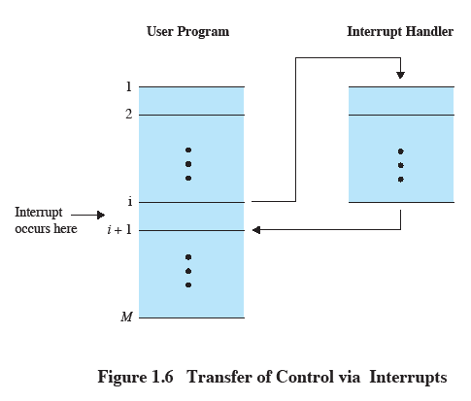
Transfer of Control via Interrupts
Notes:
For the user program, an interrupt suspends the normal sequence of execution. When the interrupt processing is completed, execution resumes ( Figure 1.6 ). Thus, the user program does not have to contain any special code to accommodate interrupts; the processor and the OS are responsible for suspending the user program and then resuming it at the same point.

Slide 37
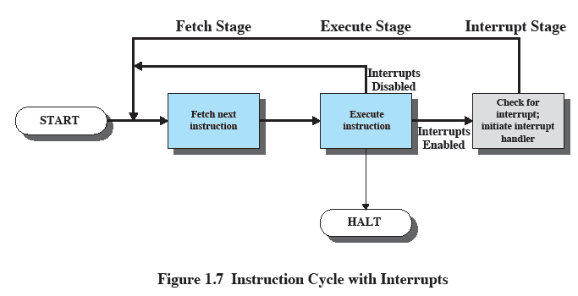
Instruction Cycle With Interrupts
Notes:
To accommodate interrupts, an interrupt stage is added to the instruction cycle, as shown in Figure 1.7 (compare Figure 1.2 ). In the interrupt stage, the processor checks to see if any interrupts have occurred, indicated by the presence of an interrupt signal. If no interrupts are pending, the processor proceeds to the fetch stage and fetches the next instruction of the current program. If an interrupt is pending, the processor suspends execution of the current program and executes an interrupthandler
routine. The interrupt-handler routine is generally part of the OS. Typically, this routine determines the nature of the interrupt and performs whatever actions are needed. In the example we have been using, the handler determines which I/O module generated the interrupt and may branch to a program that will write more data out to that I/O module. When the interrupt-handler routine is completed, the processor can resume execution of the user program at the point of interruption.
It is clear that there is some overhead involved in this process. Extra instructions must be executed (in the interrupt handler) to determine the nature of the interrupt and to decide on the appropriate action. Nevertheless, because of the relatively large amount of time that would be wasted by simply waiting on an I/O operation, the processor can be employed much more efficiently with the use of interrupts.

Slide 38
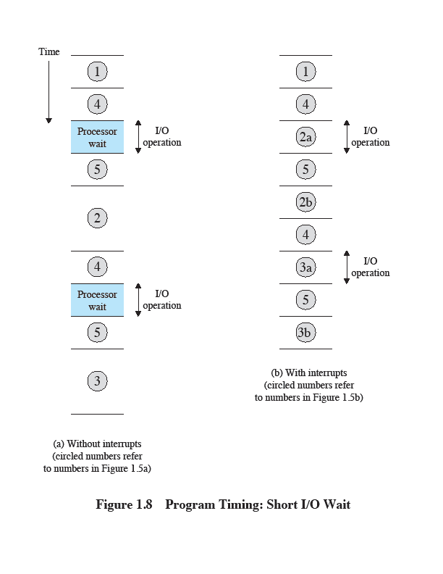
Program Timing: Short I/O Wait
Notes:
To appreciate the gain in efficiency, consider Figure 1.8 , which is a timing diagram based on the flow of control in Figures 1.5a and 1.5b . Figures 1.5b and 1.8 assume that the time required for the I/O operation is relatively short: less than the time to complete the execution of instructions between write operations in the user program. The more typical case, especially for a slow device such as a printer, is that the I/O operation will take much more time than executing a sequence of user instructions. Figure 1.5c indicates this state of affairs. In this case, the user program reaches the second WRITE call before the I/O operation spawned by the first call is complete. The result is that the user program is hung up at that point.

Slide 39
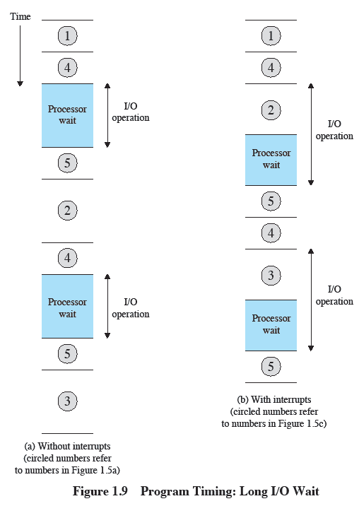
Program Timing: Long I/O wait
Notes:
When the preceding I/O operation is completed, this new WRITE call may be processed, and a new I/O operation may be started. Figure 1.9 shows the timing for this situation with
and without the use of interrupts. We can see that there is still a gain in efficiency because part of the time during which the I/O operation is underway overlaps with the execution of user instructions.

Slide 40
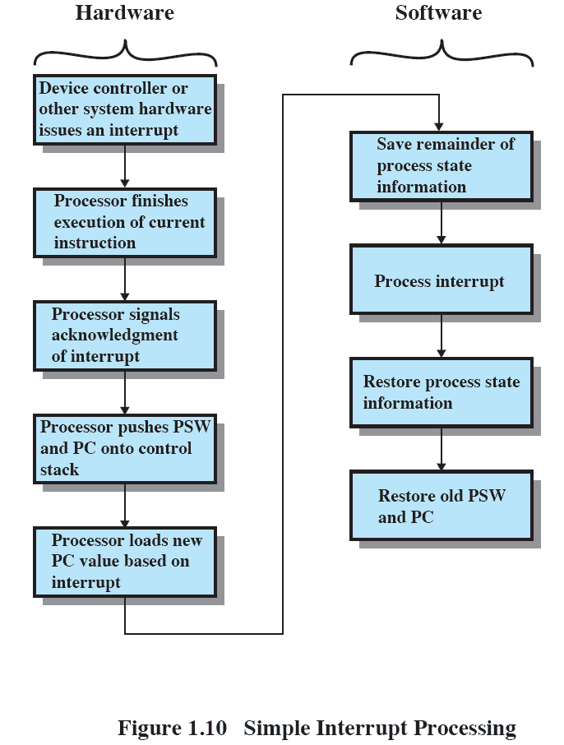
Simple Interrupt Processing
Notes:
The PSW contains status information about the currently running process, including memory usage information, condition codes, and other status information such as an interrupt enable/disable bit and a kernel/ user-mode bit. See Appendix C for further discussion.
An interrupt triggers a number of events, both in the processor hardware and in software. Figure 1.10 shows a typical sequence. When an I/O device completes an I/O operation, the following sequence of hardware events occurs:
The device issues an interrupt signal to the processor.
2. The processor finishes execution of the current instruction before responding to the interrupt, as indicated in Figure 1.7 .
3. The processor tests for a pending interrupt request, determines that there is one, and sends an acknowledgment signal to the device that issued the interrupt. The acknowledgment allows the device to remove its interrupt signal.
4. The processor next needs to prepare to transfer control to the interrupt routine. To begin, it saves information needed to resume the current program at the point of interrupt. The minimum information required is the program status word 3 (PSW) and the location of the next instruction to be executed, which is contained in the program counter (PC). These can be pushed onto a control stack (see Appendix 1B).
5. The processor then loads the program counter with the entry location of the interrupt-handling routine that will respond to this interrupt. Depending on the computer architecture and OS design, there may be a single program, one for each type of interrupt, or one for each device and each type of interrupt. If there is more than one interrupt-handling routine, the processor must determine which one to invoke. This information may have been included in the original interrupt signal, or the processor may have to issue a request to the device that issued the interrupt to get a response that contains the needed information.

Slide 41
Changes for an Interrupt
Notes:
Once the program counter has been loaded, the processor proceeds to the next instruction cycle, which begins with an instruction fetch. Because the instruction fetch is determined by the contents of the program counter, control is transferred to the interrupt-handler program. The execution of this program results in the following operations:
6. At this point, the program counter and PSW relating to the interrupted program have been saved on the control stack. However, there is other information that is considered part of the state of the executing program. In particular, the contents of the processor registers need to be saved, because these registers may be used by the interrupt handler. So all of these values,
plus any other state information, need to be saved. Typically, the interrupt handler will begin by saving the contents of all registers on the stack. Other state information that must be saved is discussed in Chapter 3 . Figure 1.11a shows a simple example. In this case, a user program is interrupted after the instruction at location N. The contents of all of the registers plus the address of the next instruction (N 1) , a total of M words, are pushed onto the control stack. The stack pointer is updated to point to the new top of stack, and the program counter is updated to point to the beginning of the interrupt service routine.
7. The interrupt handler may now proceed to process the interrupt. This includes an examination of status information relating to the I/O operation or other event that caused an interrupt. It may also involve sending additional commands or acknowledgments to the I/O device.
8. When interrupt processing is complete, the saved register values are retrieved from the stack and restored to the registers (e.g., see Figure 1.11b ).
9. The final act is to restore the PSW and program counter values from the stack. As a result, the next instruction to be executed will be from the previously
interrupted program.
It is important to save all of the state information about the interrupted program for later resumption. This is because the interrupt is not a routine called from the program. Rather, the interrupt can occur at any time and therefore at any point in the execution of a user program. Its occurrence is unpredictable..

Slide 42
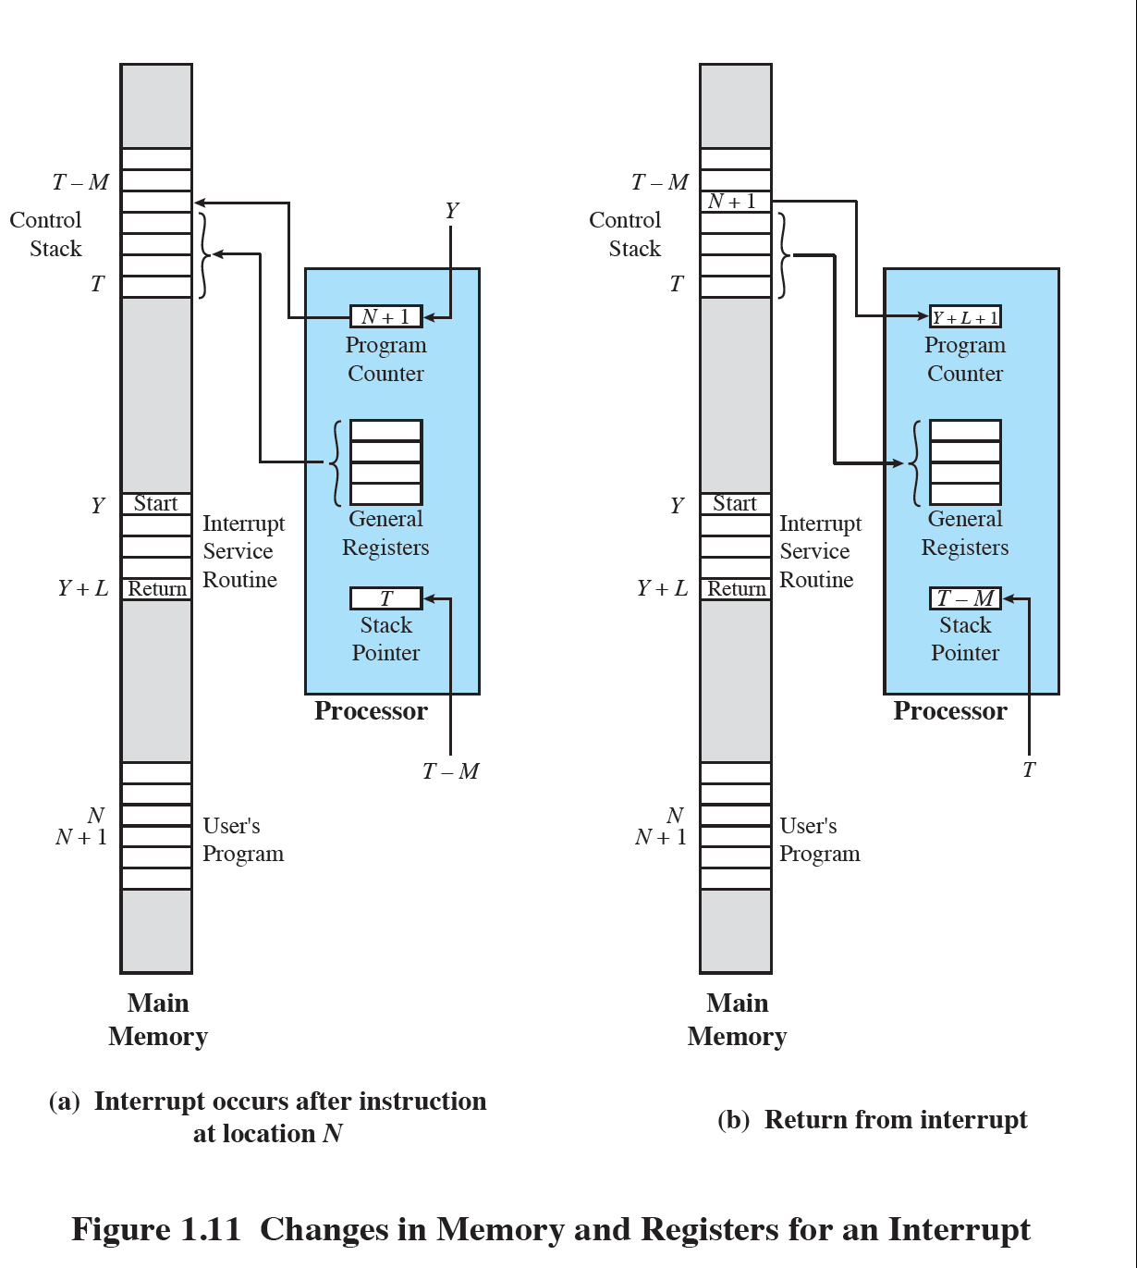

Slide 43
Multiple Interrupts
An interrupt occurs while another interrupt is being processed
e.g. receiving data from a communications line and printing results at the same time
Two approaches:
disable interrupts while an interrupt is being processed
use a priority scheme
Notes:
So far, we have discussed the occurrence of a single interrupt. Suppose, however, that one or more interrupts can occur while an interrupt is being processed. For example, a program may be receiving data from a communications line and printing results at the same time. The printer will generate an interrupt every time that it completes a print operation. The communication line controller will generate an interrupt every time a unit of data arrives. The unit could either be a single character or a block, depending on the nature of the communications discipline. In any case, it is possible for a communications interrupt to occur while a printer interrupt is being processed.

Slide 44
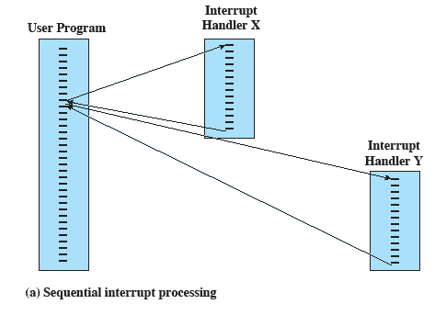
Transfer of Control With Multiple Interrupts:
Sequential
Notes:
Two approaches can be taken to dealing with multiple interrupts. The first is to disable interrupts while an interrupt is being processed. A disabled interrupt simply means that the processor ignores any new interrupt request signal. If an interrupt occurs during this time, it generally remains pending and will be checked by the processor after the processor has reenabled interrupts. Thus, if an interrupt occurs when a user program is executing, then interrupts are disabled immediately. After the interrupt-handler routine completes, interrupts are reenabled before resuming the user program, and the processor checks to see if additional interrupts have occurred. This approach is simple, as interrupts are handled in strict sequential
order ( Figure 1.12a ).

Slide 45
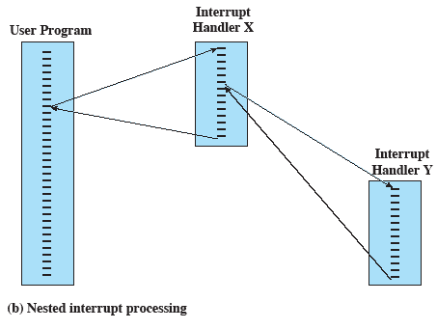
Transfer of Control With Multiple Interrupts:
Nested
Notes:
The drawback to the preceding approach is that it does not take into account relative priority or time-critical needs. For example, when input arrives from the communications line, it may need to be absorbed rapidly to make room for more input. If the first batch of input has not been processed before the second batch arrives, data may be lost because the buffer on the I/O device may fill and overflow.
A second approach is to define priorities for interrupts and to allow an interrupt of higher priority to cause a lower–priority interrupt handler to be interrupted ( Figure 1.12b ).

Slide 46
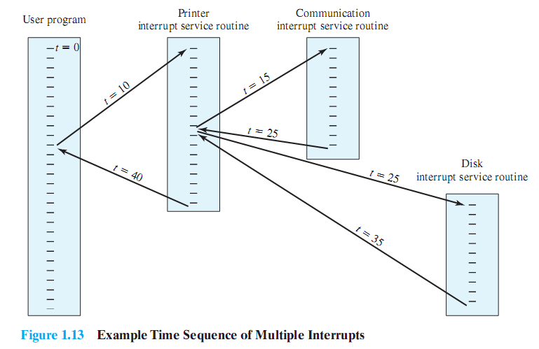
Example Time Sequence of Multiple Interrupts
Notes:
As an example of this second approach, consider a system with three I/O devices: a printer, a disk, and a communications line, with increasing priorities of 2, 4, and 5, respectively. Figure 1.13 , based on an example in [TANE06], illustrates a possible sequence. A user program begins at t 0 . At t 10 , a printer interrupt occurs; user information is placed on the control stack and execution continues at the printer interrupt service routine (ISR). While this routine is still executing, at t 15 a communications interrupt occurs. Because the communications line has
higher priority than the printer, the interrupt request is honored. The printer ISR is interrupted, its state is pushed onto the stack, and execution continues at the communications
ISR. While this routine is executing, a disk interrupt occurs (t 20) . Because this interrupt is of lower priority, it is simply held, and the communications ISR runs to completion.
When the communications ISR is complete (t 25) , the previous processor state is restored, which is the execution of the printer ISR. However, before even a single instruction in that routine can be executed, the processor honors the higherpriority disk interrupt and transfers control to the disk ISR. Only when that routine is complete (t 35) is the printer ISR resumed. When that routine completes (t 40) , control finally returns to the user program.

Slide 47
Memory Hierarchy
Major constraints in memory
amount
speed
expense
Memory must be able to keep up with the processor
Cost of memory must be reasonable in relationship to the other components
Notes:
The design constraints on a computer’s memory can be summed up by three questions: How much? How fast? How expensive?
The question of how much is somewhat open ended. If the capacity is there, applications will likely be developed to use it. The question of how fast is, in a sense, easier to answer. To achieve greatest performance, the memory must be able to keep up with the processor. That is, as the processor is executing instructions, we would not want it to have to pause waiting for instructions or operands. The final question must also be considered. For a practical system, the cost of memory must be reasonable in relationship to other components.

Slide 48
Memory Relationships
Faster access time = greater cost per bit
Greater capacity = smaller cost per bit
Greater capacity = slower access speed
Notes:
As might be expected, there is a trade-off among the three key characteristics of memory: namely, capacity, access time, and cost. A variety of technologies are used to implement memory systems, and across this spectrum of technologies, the following relationships hold:
• Faster access time, greater cost per bit
• Greater capacity, smaller cost per bit
• Greater capacity, slower access speed
The dilemma facing the designer is clear. The designer would like to use memory technologies that provide for large-capacity memory, both because the capacity is needed and because the cost per bit is low. However, to meet performance requirements, the designer needs to use expensive, relatively lower-capacity memories with fast access times.

Slide 49
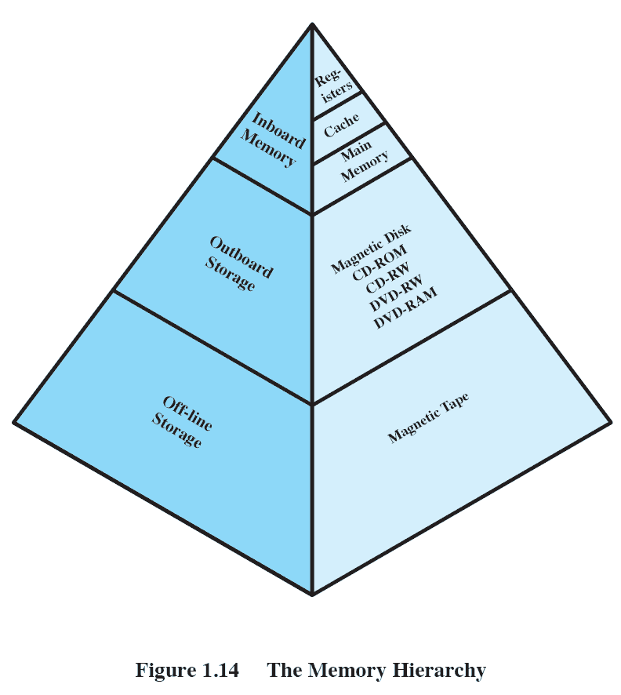
The Memory Hierarchy
Going down the hierarchy:
decreasing cost per bit
increasing capacity
increasing access time
decreasing frequency of access to the memory by the processor
Notes:
The way out of this dilemma is to not rely on a single memory component or technology, but to employ a memory hierarchy . A typical hierarchy is illustrated in
Figure 1.14 . As one goes down the hierarchy, the following occur:
a. Decreasing cost per bit
b. Increasing capacity
c. Increasing access time
d. Decreasing frequency of access to the memory by the processor
Thus, smaller, more expensive, faster memories are supplemented by larger, cheaper, slower memories. The key to the success of this organization is the decreasing
frequency of access at lower levels. We will examine this concept in greater detail later in this chapter, when we discuss the cache, and when we discuss virtual
memory later in this book. A brief explanation is provided at this point.
Suppose that the processor has access to two levels of memory. Level 1 contains 1,000 bytes and has an access time of 0.1 μs; level 2 contains 100,000 bytes and has an access time of 1 μs. Assume that if a byte to be accessed is in level 1, then the processor accesses it directly. If it is in level 2, then the byte is first transferred to level 1 and then accessed by the processor. For simplicity, we ignore the time required for the processor to determine whether the byte is in level 1 or level 2.

Slide 50
Performance of a Simple Two-Level Memory
Suppose that the processor has access to two levels of memory.
level 1 contains 1,000 bytes and has an access time of 0.1 μs;
level 2 contains 100,000 bytes and has an access time of 1 μs.
Assume
if a byte to be accessed is in level 1, then the processor accesses it directly.
If it is in level 2, then the byte is first transferred to level 1 and then accessed by the processor.
For simplicity, we ignore the time required for the processor to determine whether the byte is in level 1 or level 2.
Figure 1.15 Performance of a Simple Two-Level Memory
Notes:
Suppose that the processor has access to two levels of memory. Level 1 contains 1,000 bytes and has an access time of 0.1 μs; level 2 contains 100,000 bytes and has an access time of 1 μs. Assume that if a byte to be accessed is in level 1, then the processor accesses it directly. If it is in level 2, then the byte is first transferred to level 1 and then accessed by the processor. For simplicity, we ignore the time required for the processor to determine whether the byte is in level 1 or level 2.
Figure 1.15 shows the general shape of the curve that models this situation. The figure shows the average access time to a two-level memory as a function of the hit ratio H , where H is defined as the fraction of all memory accesses that are found in the faster memory (e.g., the cache), T 1 is the access time to level 1, and T 2 is the access time to level 2. 4 As can be seen, for high percentages of level 1 access, the average total access time is much closer to that of level 1 than that of level 2.
In our example, suppose 95% of the memory accesses are found in the cache (H 0.95) . Then the average time to access a byte can be expressed as
(0.95) (0.1 s) (0.05) (0.1 s 1 s) 0.095 0.055 0.15 s
The result is close to the access time of the faster memory. So the strategy of using two memory levels works in principle, but only if conditions (a) through (d) in the preceding list apply. By employing a variety of technologies, a spectrum of memory systems exists that satisfies conditions (a) through (c). Fortunately, condition (d) is also generally valid.

Slide 51
Computing average time to access a byte
hit ratio H ,
the fraction of all memory accesses that are found in the faster memory (e.g., the cache)
example,
Suppose 95% of the memory accesses are found in the cache (H = 0.95) . Then the average time to access a byte can be expressed as
(0.95) (0.1 μs) + (0.05) (0.1 μs + 1 μs) = 0.095 + 0.055 =0.15 μs
Figure 1.15 Performance of a Simple Two-Level Memory
Notes:
Suppose that the processor has access to two levels of memory. Level 1 contains 1,000 bytes and has an access time of 0.1 μs; level 2 contains 100,000 bytes and has an access time of 1 μs. Assume that if a byte to be accessed is in level 1, then the processor accesses it directly. If it is in level 2, then the byte is first transferred to level 1 and then accessed by the processor. For simplicity, we ignore the time required for the processor to determine whether the byte is in level 1 or level 2.
Figure 1.15 shows the general shape of the curve that models this situation. The figure shows the average access time to a two-level memory as a function of the hit ratio H , where H is defined as the fraction of all memory accesses that are found in the faster memory (e.g., the cache), T 1 is the access time to level 1, and T 2 is the access time to level 2. 4 As can be seen, for high percentages of level 1 access, the average total access time is much closer to that of level 1 than that of level 2.
In our example, suppose 95% of the memory accesses are found in the cache (H 0.95) . Then the average time to access a byte can be expressed as
(0.95) (0.1 s) (0.05) (0.1 s 1 s) 0.095 0.055 0.15 s
The result is close to the access time of the faster memory. So the strategy of using two memory levels works in principle, but only if conditions (a) through (d) in the preceding list apply. By employing a variety of technologies, a spectrum of memory systems exists that satisfies conditions (a) through (c). Fortunately, condition (d) is also generally valid.

Slide 52
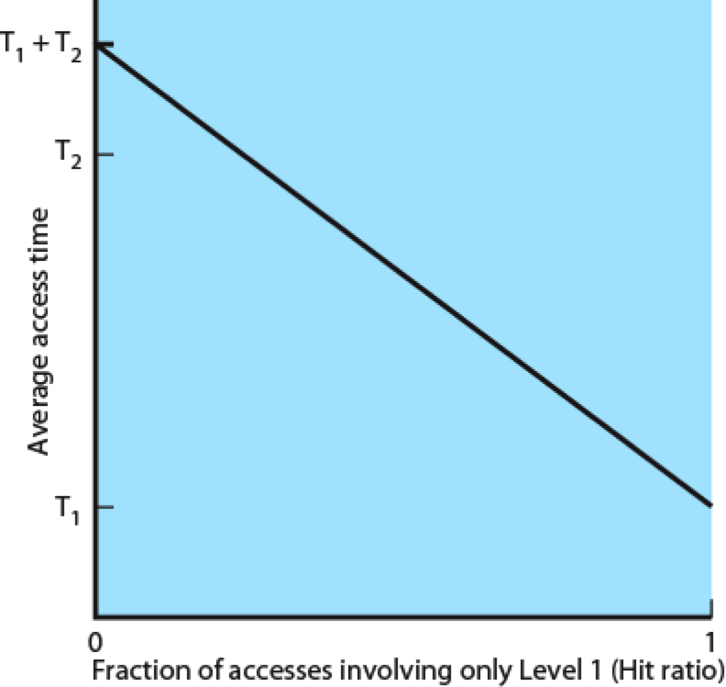
Performance of a Simple Two-Level Memory
Figure 1.15 Performance of a Simple Two-Level Memory
Notes:
Suppose that the processor has access to two levels of memory. Level 1 contains 1,000 bytes and has an access time of 0.1 μs; level 2 contains 100,000 bytes and has an access time of 1 μs. Assume that if a byte to be accessed is in level 1, then the processor accesses it directly. If it is in level 2, then the byte is first transferred to level 1 and then accessed by the processor. For simplicity, we ignore the time required for the processor to determine whether the byte is in level 1 or level 2.
Figure 1.15 shows the general shape of the curve that models this situation. The figure shows the average access time to a two-level memory as a function of the hit ratio H , where H is defined as the fraction of all memory accesses that are found in the faster memory (e.g., the cache), T 1 is the access time to level 1, and T 2 is the access time to level 2. 4 As can be seen, for high percentages of level 1 access, the average total access time is much closer to that of level 1 than that of level 2.
In our example, suppose 95% of the memory accesses are found in the cache (H 0.95) . Then the average time to access a byte can be expressed as
(0.95) (0.1 s) (0.05) (0.1 s 1 s) 0.095 0.055 0.15 s
The result is close to the access time of the faster memory. So the strategy of using two memory levels works in principle, but only if conditions (a) through (d) in the preceding list apply. By employing a variety of technologies, a spectrum of memory systems exists that satisfies conditions (a) through (c). Fortunately, condition (d) is also generally valid.

Slide 53

Secondary Memory
Also referred to as auxiliary memory
External
Nonvolatile
Used to store program and data files
Notes:
The three forms of memory just described are, typically, volatile and employ semiconductor technology. The use of three levels exploits the fact that semiconductor memory comes in a variety of types, which differ in speed and cost. Data are stored more permanently on external mass storage devices, of which the most common are hard disk and removable media, such as removable disk, tape, and optical storage. External, nonvolatile memory is also referred to as secondary memory or auxiliary memory . These are used to store program and data files, and are usually visible to the programmer only in terms of files and records, as opposed to individual bytes or words. A hard disk is also used to provide an extension to main memory known as virtual memory, which is discussed in Chapter 8 .

Slide 54
Cache Memory
Invisible to the OS
Interacts with other memory management hardware
Processor must access memory at least once per instruction cycle
Processor execution is limited by memory cycle time
Notes:
Although cache memory is invisible to the OS, it interacts with other memory management hardware. Furthermore, many of the principles used in virtual memory schemes (discussed in Chapter 8 ) are also applied in cache memory.
On all instruction cycles, the processor accesses memory at least once, to fetch the instruction, and often one or more additional times, to fetch operands and/ or store results. The rate at which the processor can execute instructions is clearly limited by the memory cycle time (the time it takes to read one word from or write one word to memory). This limitation has been a significant problem because of the persistent mismatch between processor and main memory speeds: Over the years, processor speed has consistently increased more rapidly than memory access speed. We are faced with a trade-off among speed, cost, and size. Ideally, main memory should be built with the same technology as that of the processor registers, giving memory cycle times comparable to processor cycle times. This has always been too expensive a strategy. The solution is to exploit the principle of locality by providing a small, fast memory between the processor and main memory, namely the cache.

Slide 55
Cache Principles
Contains a copy of a portion of main memory
Processor first checks cache
If not found, a block of memory is read into cache
Because of locality of reference, it is likely that many of the future memory references will be to other bytes in the block
Notes:
Cache memory is intended to provide memory access time approaching that of the fastest memories available and at the same time support a large memory size that has the price of less expensive types of semiconductor memories. The concept is illustrated in Figure 1.16a . There is a relatively large and slow main memory together with a smaller, faster cache memory. The cache contains a copy of a portion of main memory. When the processor attempts to read a byte or word of memory, a check is made to determine if the byte or word is in the cache. If so, the byte or word is delivered to the processor. If not, a block of main memory, consisting of some fixed number of bytes, is read into the cache and then the byte or word is delivered to
the processor. Because of the phenomenon of locality of reference, when a block of data is fetched into the cache to satisfy a single memory reference, it is likely that many of the near-future memory references will be to other bytes in the block.

Slide 56
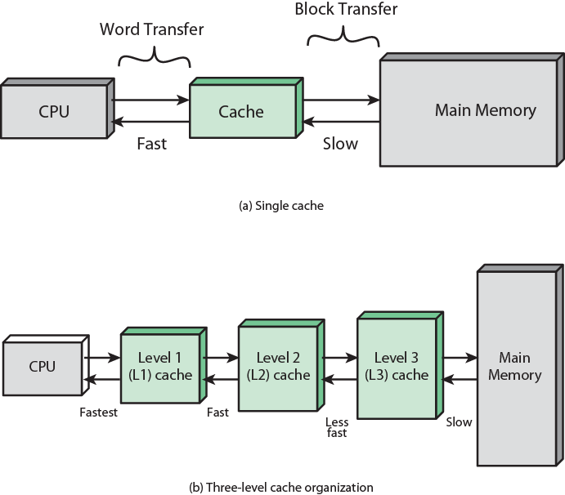
Cache and Main Memory
Notes:
Cache and main memory illustration.
Figure 1.16b depicts the use of multiple levels of cache. The L2 cache is slower and typically larger than the L1 cache, and the L3 cache is slower and typically larger than the L2 cache.

Slide 57
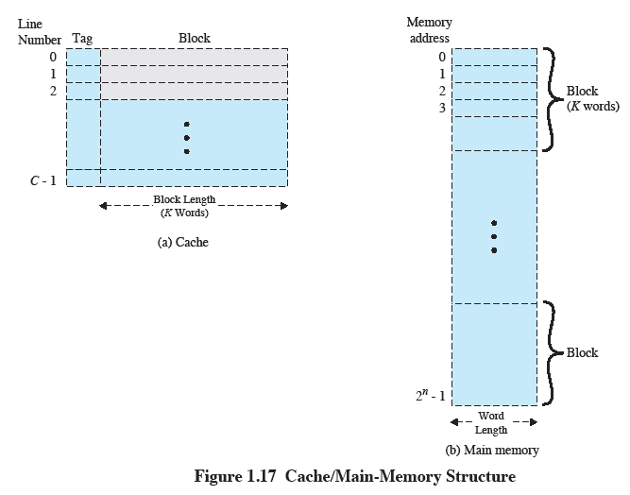
Cache/Main-Memory Structure
Notes:
Figure 1.17 depicts the structure of a cache/main memory system. Main memory consists of up to 2 n addressable words, with each word having a unique n –bit address. For mapping purposes, this memory is considered to consist of a number of fixed-length blocks of K words each. That is, there are M 2n/K blocks. Cache consists of C slots (also referred to as lines ) of K words each, and the number of slots is considerably less than the number of main memory blocks (CM) . 5 Some subset of the blocks of main memory resides in the slots of the cache. If a word in a block of memory that is not in the cache is read, that block is transferred to one of the slots of the cache. Because there are more blocks than slots, an individual slot cannot be uniquely and permanently dedicated to a particular block. Therefore, each slot includes a tag that identifies which particular block is currently being stored. The tag is usually some number of higher-order bits of the address and refers to all addresses that begin with that sequence of bits.

Slide 58
Tags and address
Main memory consists of up to 2 ^{n} addressable words, with each word having a unique n –bit address.
For mapping purposes, this memory is considered to consist of a number of fixed-length blocks of K words each.
That is, there are M = 2^{n}/K blocks.
Cache consists of C slots (also referred to as lines ) of K words each, and the number of slots is considerably less than the number of main memory blocks (C<<M)

Slide 59
Mapping Tags and address
Suppose
6 bits address
2 bits tag
Tag 01
01|0000, 01|0001, ……..01|1111

Slide 60
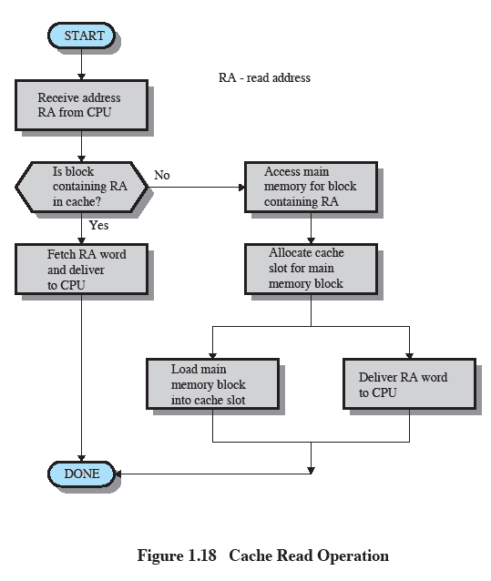
Cache Read Operation
Notes:
Figure 1.18 illustrates the read operation. The processor generates the address, RA, of a word to be read. If the word is contained in the cache, it is delivered to the processor. Otherwise, the block containing that word is loaded into the cache and the word is delivered to the processor.

Slide 61
Cache Design
Main categories are:
cache size
block size
mapping function
write policy
number of cache levels
replacement algorithm
Notes:
A detailed discussion of cache design is beyond the scope of this book. Key elements are briefly summarized here. We will see that similar design issues must be addressed in dealing with virtual memory and disk cache design. They fall into the following categories:
• Cache size
• Block size
• Mapping function
• Replacement algorithm
• Write policy
• Number of cache levels

Slide 62
Cache and Block Size
Cache Size
Small caches have significant impact on performance
Block Size
The unit of data exchanged between cache and main memory
Notes:
We have already dealt with the issue of cache size . It turns out that reasonably small caches can have a significant impact on performance. Another size issue is that of block size : the unit of data exchanged between cache and main memory. As the block size increases from very small to larger sizes, the hit ratio will at first increase because of the principle of locality: the high probability that data in the vicinity of a referenced word are likely to be referenced in the near future. As the block size increases, more useful data are brought into the cache. The hit ratio will begin to decrease, however, as the block becomes even bigger and the probability of using the newly fetched data becomes less than the probability of reusing the data that have to be moved out of the cache to make room for the new block.

Slide 63
Mapping Function
Determines which cache location the block will occupy
Two constraints affect design:
When one block is read in, another may have to be replaced
The more flexible the mapping function, the more complex is the circuitry required to search the cache
Notes:
When a new block of data is read into the cache, the mapping function determines which cache location the block will occupy. Two constraints affect the design of the mapping function. First, when one block is read in, another may have to be replaced. We would like to do this in such a way as to minimize the probability that we will replace a block that will be needed in the near future. The more flexible the mapping function, the more scope we have to design a replacement algorithm to maximize the hit ratio. Second, the more flexible the mapping function, the more complex is the circuitry required to search the cache to determine if a given block is in the cache.

Slide 64
Replacement Algorithm
Least Recently Used (LRU) Algorithm
effective strategy is to replace a block that has been in the cache the longest with no references to it
hardware mechanisms are needed to identify the least recently used block
chooses which block to replace when a new block is to be loaded into the cache
Notes:
The replacement algorithm chooses, within the constraints of the mapping function, which block to replace when a new block is to be loaded into the cache and the cache already has all slots filled with other blocks. We would like to replace the block that is least likely to be needed again in the near future. Although it is impossible to identify such a block, a reasonably effective strategy is to replace the block that has been in the cache longest with no reference to it. This policy is referred to as the least-recently-used (LRU) algorithm. Hardware mechanisms are needed to identify the least-recently-used block.

Slide 65
Write Policy
Dictates when the memory write operation takes place
can occur every time the block is updated
can occur when the block is replaced
minimizes write operations
leaves main memory in an obsolete state
Notes:
If the contents of a block in the cache are altered, then it is necessary to write it back to main memory before replacing it. The write policy dictates when the memory write operation takes place. At one extreme, the writing can occur every time that the block is updated. At the other extreme, the writing occurs only when the block is replaced. The latter policy minimizes memory write operations but leaves main memory in an obsolete state. This can interfere with multiple-processor operation and with direct memory access by I/O hardware modules.

Slide 66
I/O Techniques
When the processor encounters an instruction relating to I/O, it executes that instruction by issuing a command to the appropriate I/O module
Three techniques are possible for I/O operations:
Programmed I/O
Interrupt-Driven I/O
Direct Memory Access (DMA)
Notes:
When the processor is executing a program and encounters an instruction relating to I/O, it executes that instruction by issuing a command to the appropriate I/O module.
Three techniques are possible for I/O operations: programmed I/O, interrupt-driven I/O, and direct memory access (DMA).

Slide 67
Programmed I/O
The I/O module performs the requested action then sets the appropriate bits in the I/O status register
The processor periodically checks the status of the I/O module until it determines the instruction is complete
With programmed I/O the performance level of the entire system is severely degraded
Notes:
In the case of programmed I/O , the I/O module performs the requested action and then sets the appropriate bits in the I/O status register but takes no further action to alert the processor. In particular, it does not interrupt the processor. Thus, after the I/O instruction is invoked, the processor must take some active role in determining when the I/O instruction is completed. For this purpose, the processor periodically checks the status of the I/O module until it finds that the operation is complete.
With programmed I/O, the processor has to wait a long time for the I/O module of concern to be ready for either reception or transmission of more data. The processor, while waiting, must repeatedly interrogate the status of the I/O module. As a result, the performance level of the entire system is severely degraded.

Slide 68
Interrupt-Driven I/O
Processor issues an I/O command to a module and then goes on to do some other useful work
The processor executes the data transfer and then resumes its former processing
The I/O module will then interrupt the processor to request service when it is ready to exchange data with the processor
More efficient than Programmed I/O but still requires active intervention of the processor to transfer data between memory and an I/O module
Notes:
An alternative, known as interrupt-driven I/O , is for the processor to issue an I/O command to a module and then go on to do some other useful work. The I/O module will then interrupt the processor to request service when it is ready to exchange data with the processor. The processor then executes the data transfer, as before, and then resumes its former processing.

Slide 69
Interrupt-Driven I/O Drawbacks
Transfer rate is limited by the speed with which the processor can test and service a device
The processor is tied up in managing an I/O transfer
a number of instructions must be executed for each I/O transfer
Notes:
Interrupt-driven I/O, though more efficient than simple programmed I/O, still requires the active intervention of the processor to transfer data between memory and an I/O module, and any data transfer must traverse a path through the processor. Thus, both of these forms of I/O suffer from two inherent drawbacks:
1. The I/O transfer rate is limited by the speed with which the processor can test and service a device.
2. The processor is tied up in managing an I/O transfer; a number of instructions must be executed for each I/O transfer.

Slide 70
Direct Memory Access (DMA)
Performed by a separate module on the system bus or incorporated into an I/O module
When the processor wishes to read or write data it issues a command to the DMA module containing:
whether a read or write is requested
the address of the I/O device involved
the starting location in memory to read/write
the number of words to be read/written
Notes:
When large volumes of data are to be moved, a more efficient technique is required: direct memory access (DMA) . The DMA function can be performed by a separate module on the system bus or it can be incorporated into an I/O module. In either case, the technique works as follows. When the processor wishes to read or write a block of data, it issues a command to the DMA module, by sending to the DMA module the following information:
• Whether a read or write is requested
• The address of the I/O device involved
• The starting location in memory to read data from or write data to
• The number of words to be read or written

Slide 71
Direct Memory Access
Transfers the entire block of data directly to and from memory without going through the processor
processor is involved only at the beginning and end of the transfer
processor executes more slowly during a transfer when processor access to the bus is required
More efficient than interrupt-driven or programmed I/O
Notes:
The processor then continues with other work. It has delegated this I/O operation to the DMA module, and that module will take care of it. The DMA module transfers the entire block of data, one word at a time, directly to or from memory without going through the processor. When the transfer is complete, the DMA module sends an interrupt signal to the processor. Thus, the processor is involved only at the beginning and end of the transfer. The DMA module needs to take control of the bus to transfer data to and from memory. Because of this competition for bus usage, there may be times when the processor needs the bus and must wait for the DMA module. Note that this is not an interrupt; the processor does not save a context and do something else. Rather, the processor pauses for one bus cycle (the time it takes to transfer one word across the bus). The overall effect is to cause the processor to execute more slowly during a DMA transfer when processor access to the bus is required. Nevertheless, for a multiple-word I/O transfer, DMA is far more efficient than interrupt-driven or programmed I/O.

Slide 72
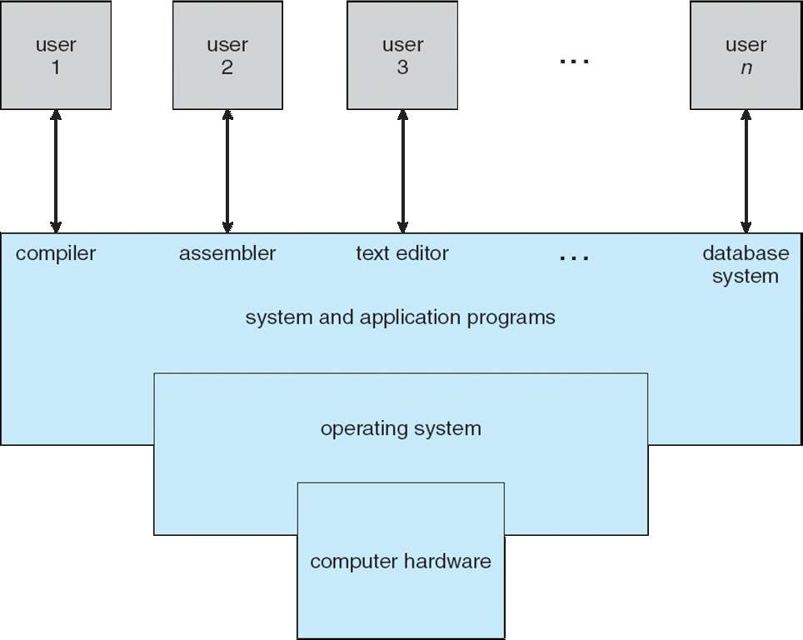
Components of a Computer System
72

Slide 73
Components of a Computer System
Computer system can be divided into four components
Hardware
Provides basic computing resources
CPU, memory, I/O devices
Operating system
Controls & coordinates use of hardware among various applications and users
Application programs
Define the ways in which the system resources are used to solve the computing problems of the users
For example, word processors, compilers, web browsers, database systems, video games
Users
People, machines, other computers
73

Slide 74
Operating System
Provides a set of services to system users
Intermediary between user and hardware
Shield between the user and the hardware
Resource manager
CPU(s), memory, I/O devices
Objectives
Convenience (to use)
Efficiency (utilization of hardware)
Ability to evolve
Applications
Interfaces
Operating System (Set of Services)
Hardware specific Interface
Hardware
74

Slide 75
Operating System Viewpoints
Use view
Users want convenience, ease of use
Don’t care about resource utilization
System view
Resource allocator
Manages all resources
Decides between conflicting requests for efficient and fair resource use
Control program
Controls execution of programs to prevent errors and improper use of the computer
75

Slide 76
Services Provided by the Operating System
Program execution
CPU scheduling, resource (memory) allocation and management, synchronization
Access to I/O devices
Uniform interfaces, hide details, optimize resources (disk scheduling)
Controlled access to files
Structure of data
System/resource access
Allocation, authorization, protection,
Utilities, e.g., for program development
Compilers, debuggers
Error detection and response, when, e.g.,
Hardware, software errors
Operating system cannot grant request of application
Monitoring, accounting
76

Slide 77
Some History: Evolution of Operating Systems
Hardware upgrades, new types of hardware, enabled features
New services, new needs
Development
Serial processing (1948 – 1955)
Batch systems (1955 for IBM)
Multiprogramming
Time shared systems (1966: Compatible Time Sharing System (CTSS) by MIT)
Before 1948?
77

Slide 78
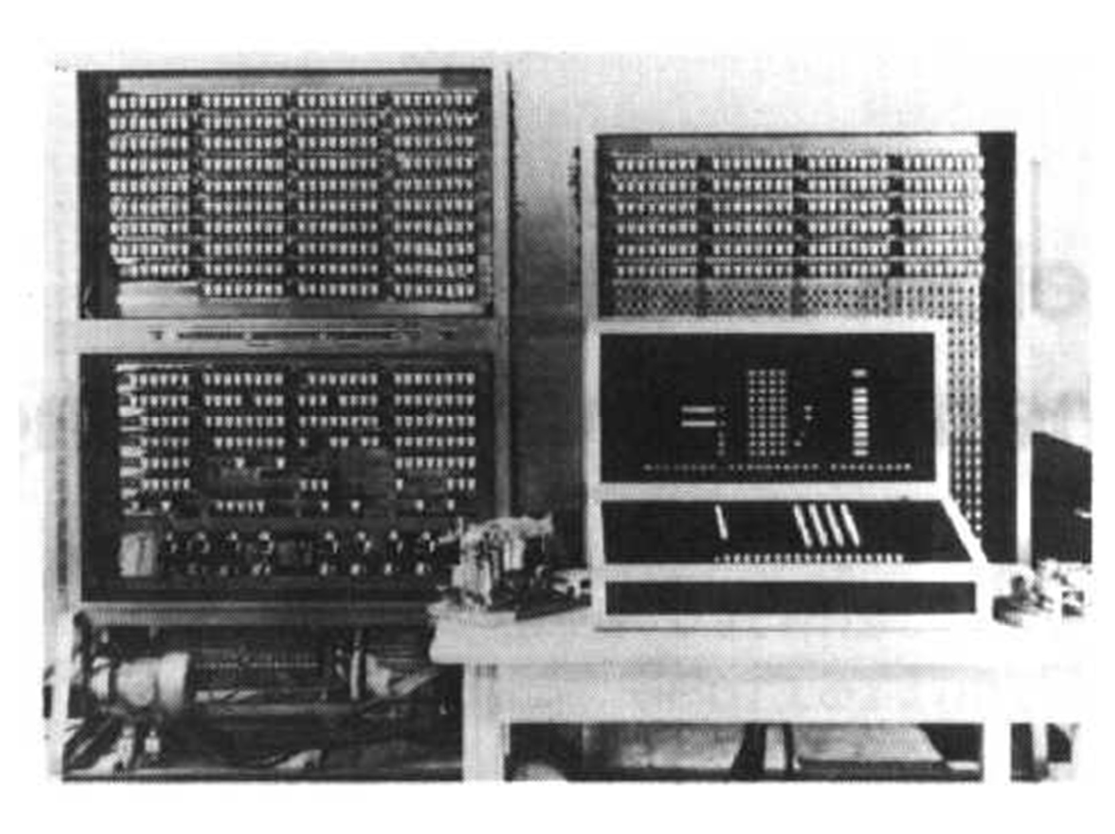
Konrad Zuse (1910-1995) / Z3 (1941)
0-Preliminaries
10

Slide 79
OS History: Serial Processing (Before the Stone Age)
No operating system
System model
Simple console: display lights and toggle switches
Input device (card reader)
Execution monitoring
Output on a printer (job went well)
Control lights for error detection (check status of registers)
Job scheduling
Manual (reservations on a piece of paper)
Overestimation of execution time
Low utilization of CPU
11

Slide 80
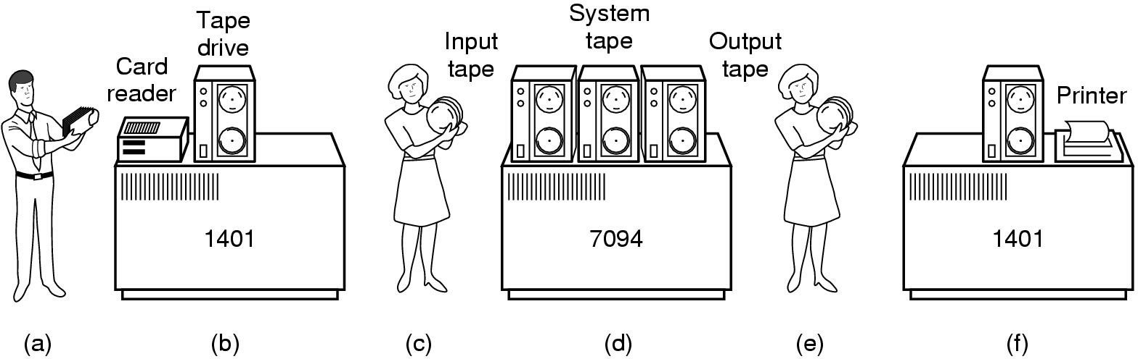
OS History: Early Batch System
Programmer bring cards to 1401
1401 reads batch of jobs onto tape
Operator caries input tape to 7094
7094 does computing
Operator carries output tape to 1401
1401 prints output
12

Slide 81
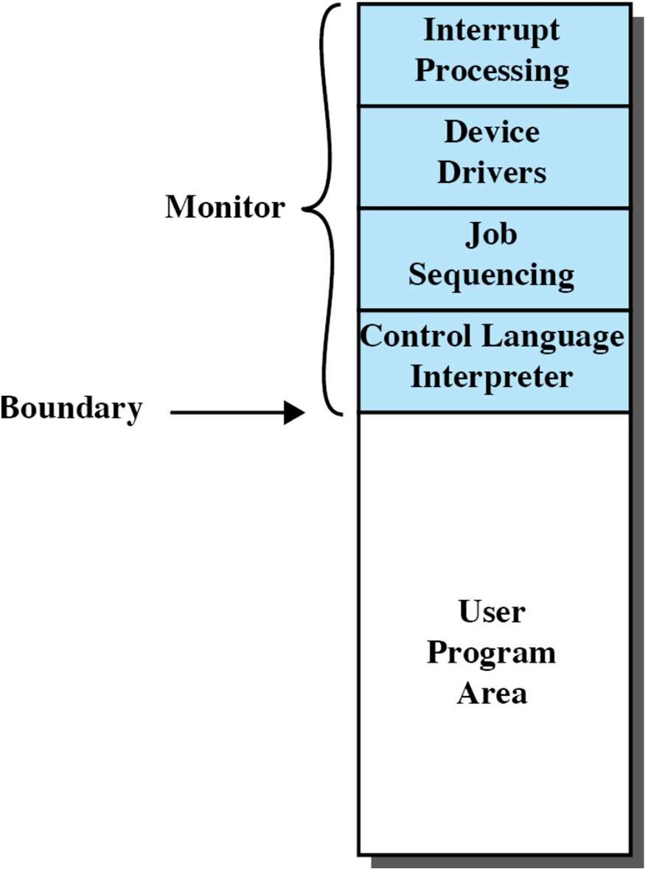
OS History: First “Tools” Appear
Simple Batch Systems
Goal
Improve machine utilization
Monitors
Software that controls the running programs
Batch jobs together
Program returns control to monitor when finished
Resident monitor is in main memory and available for execution
Job Control Language (JCL)
Provides instruction to the monitor
What compiler to use, (Fortran, …)
What data to use
13

Slide 82
OS History: Hardware Features…
… which made the first tools possible
Memory protection
Do not allow the memory area containing the monitor to be altered
On attempt processor hardware should detect an error
Concepts of mode operation
User mode: certain areas of memory are protected / some instructions not allowed
Kernel mode: allows access to protected memory / execution of special instructions
Privileged instructions
Only for monitor, e.g., for interface with I/O devices
Interrupts
Mechanisms for the OS to relinquish control and regain it
Timer
After timeout job return to the monitor
Prevents a job from monopolizing the system
14

Slide 83

From Uniprogramming …
Processor must wait for I/O instruction to complete before proceeding
One job prevents others from making progress
15

Slide 84
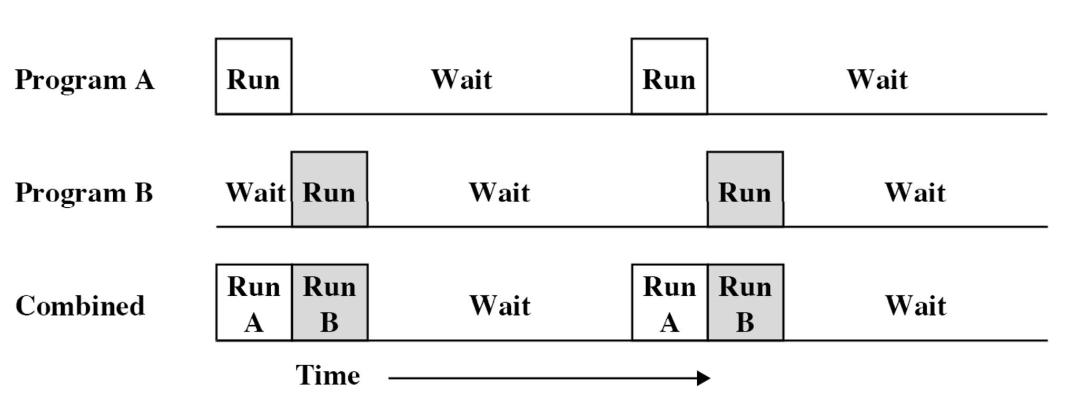
… To Multiprogramming
Increases processor utilization
When one job needs to wait for I/O, the processor can switch to the other job
16

Slide 85
Obvious Disadvantages
Certainly not suitable for modern applications
Word processing
Even if computation only matters
Long response for a developer until feedback is received
Time until job is dispatched typically long
Need for interactivity with a computer system
17

Slide 86
OS History: Multiprogramming, Time Sharing
Time sharing systems use multiprogramming to handle multiple interactive jobs
Processor’s time is shared among multiple users
Multiple users simultaneously access the system through terminals
 | Batch Multiprogramming | Time Sharing
Principal objective | Maximize processor use | Minimize response time
Source of directives to operating system | Job control language commands provided with the job | Commands entered at the terminal
18

Slide 87
Hardware Protection
Dual-Mode Operation
I/O Protection
Memory Protection
CPU Protection

Slide 88
Dual-Mode Operation
Sharing system resources requires operating system to ensure that an incorrect program cannot cause other programs to execute incorrectly.
Provide hardware support to differentiate between at least two modes of operations.
User mode – execution done on behalf of a user.
Monitor mode (also kernel mode or system mode) – execution done on behalf of operating system.

Slide 89
Dual-Mode Operation …
Mode bit added to computer hardware to indicate the current mode: monitor (0) or user (1).
When an interrupt or fault occurs hardware switches to monitor mode.
Interrupt/fault
monitor
user
set user mode
Privileged instructions can be issued only in monitor mode.

Slide 90
Memory Management
Basic concepts
Various techniques for memory management
Logical to physical address translation
Swapping
Contiguous memory allocation: MFT, MVT
External fragmentation
Paging
Hardware support for paging
Internal fragmentation

Slide 91
Memory Protection
Must provide memory protection outside the address space of a process.
In order to have memory protection, add two registers that determine the range of legal addresses a program may access:
Base register – holds the smallest legal physical memory address.
Limit register – contains the size of the range
Memory outside the defined range is protected.

Slide 92
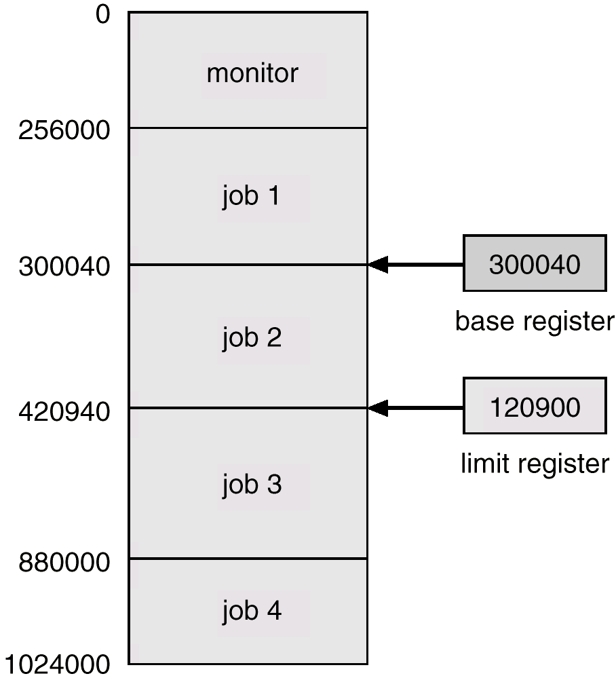
Use of Base and Limit Register

Slide 93
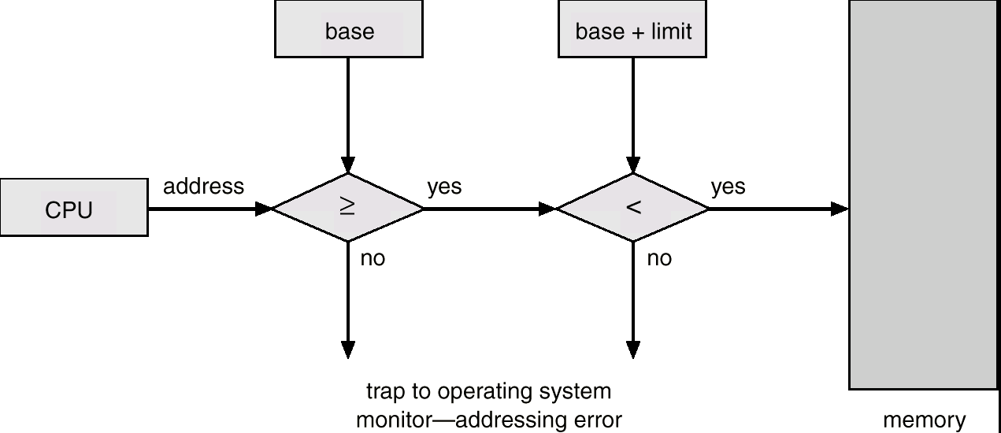
Hardware Support

Slide 94
I/O Protection
All I/O instructions are privileged instructions.
Must ensure that a user program could never gain control of the computer in monitor mode (i.e., a user program that, as part of its execution, stores a new address in the interrupt vector).

Slide 95
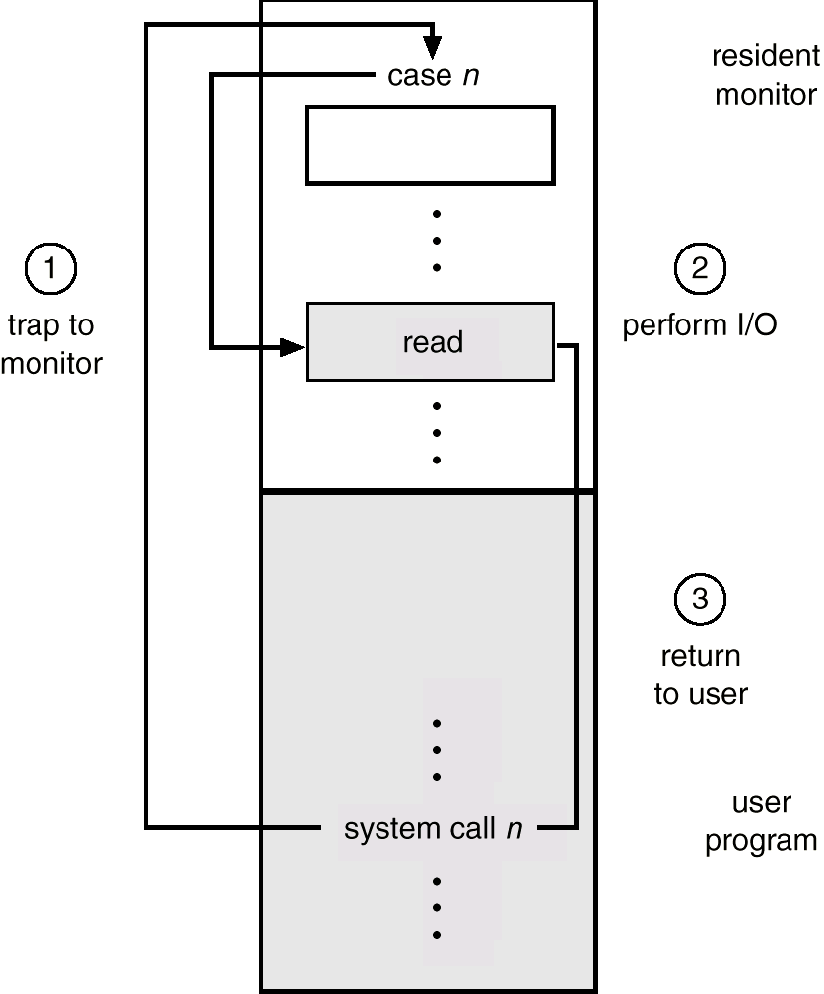
Use of A System Call to Perform I/O

Slide 96
CPU Protection
Timer – interrupts computer after specified period to ensure operating system maintains control.
Timer is decremented every clock tick.
When timer reaches the value 0, an interrupt occurs.
Timer commonly used to implement time sharing.
Time also used to compute the current time.
Load-timer is a privileged instruction.
Notes:
Prevent the user program getting stuck in an infinite loop, and never returning control to OS. Use timer. After certain time, an interrupt occurs. Before turning control to user, OS loads up the timer to interrupt. Once the timer interrupt occurs, control is back to OS. At this point OS may send out a fatal error message or may increase the timer limit.
It is used in time sharing environments. Also it is used to compute the wall time.

Slide 97
OS Components
Process management
Main memory management
Secondary storage management
I/O system management
File management
Protection system
Networking
Command-line interpreter (shells)

Slide 98
Operating System Services
Services for user and users of programs:
Program execution
I/O Operations
File System Manipulation
Communications between processes/users
Error detection and handling
Services for efficient system operation:
Resource management
Accounting
Protection

Slide 99
Summary
Basic Elements
processor, main memory, I/O modules, system bus
GPUs, SIMD, DSPs, SoC
Instruction execution
processor-memory, processor-I/O, data processing, control
Interrupt/Interrupt Processing
Memory Hierarchy
Cache/cache principles and designs
Multiprocessor/multicore
Notes:
Summary of Chapter 1.

Slide 100

Any Question So Far?

